Slide 1
WEEK 1: LESSON2
PERIODIC TABLE

Slide 2
THE PERIODIC TABLE
The periodic table arranges the elements in order of increasing atomic number.
History of the PT
The first PT was developed by Dmitri Mendeleev in 1869 and was first able to be arranged in the current structure.

Slide 3
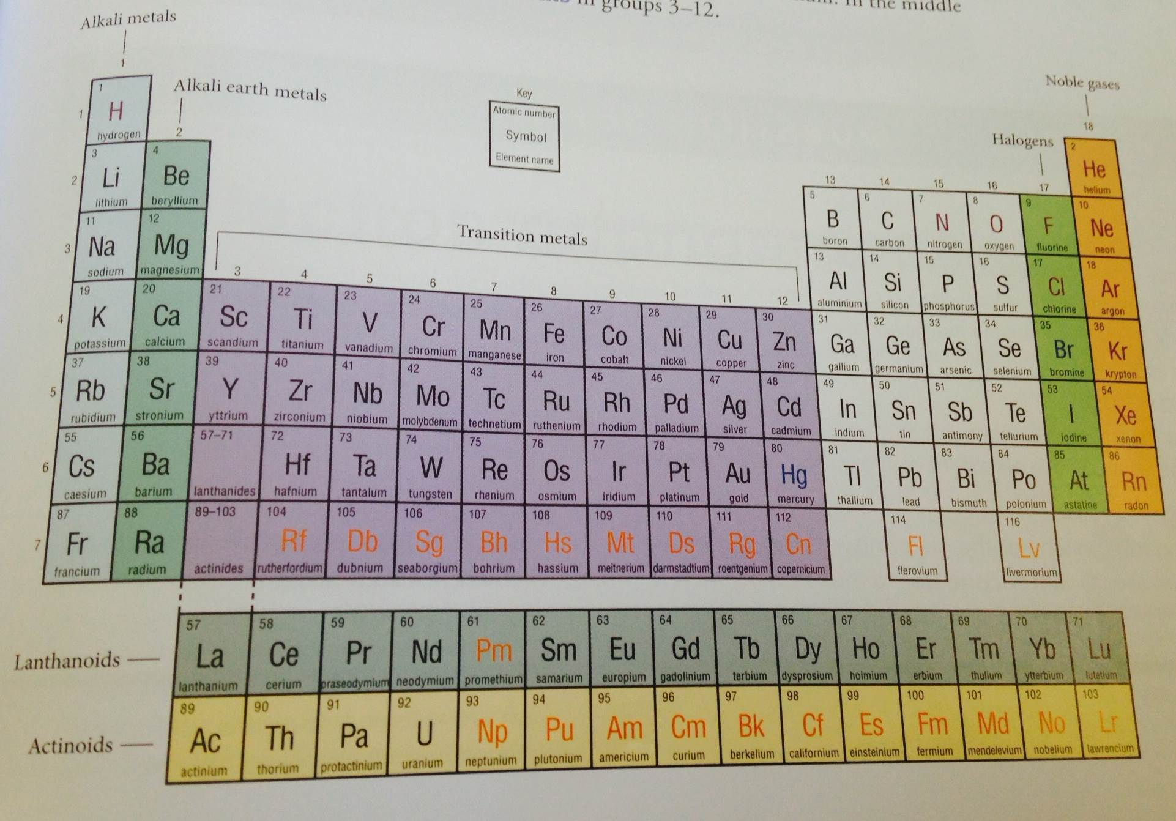

Slide 4
ARRANGEMENT OF PERIODIC TABLE
The PT is arranged in a series of horizontal rows called periods vertical columns called groups.
Elements are in order of their atomic number from left to right in each row.
Group I is often referred to as the alkali metals. In the middle of the PT ( groups 3-12 ) are the transition elements.

Slide 5
The structure of the periodic table is based on the atomic number and the properties of the elements.
Each of the elements in the same group shows similar chemical properties. E.g. during reaction with water, group I elements will form a metal hydroxide and hydrogen gas.
2Na+ 2H₂O ➔ 2NaOH + H₂
The reactivity of the elements in group I increases down the group.
Metals appear on the LHS of the table, non-metals are on the RHS and metalloids are in a diagonal strip between them.
A metalloid is an element that has properties of both metals and non-metals. E.g. B, Si, Sb -----
Refer page: 48 of Essential Chemistry Units 1 & 2

Slide 6
Do questions from page: 51 Essential Chemistry Unit 1 & 2
Question1) a and d
Question 2) a and b

Slide 7
QUANTUM MECHANICAL MODEL OF ELECTRON ARRANGEMENT
This model as first proposed by Bohr can help to explain the repeating chemical behaviour of elements by relating an element’s chemical and physical properties to the number of electrons it has and the way they are arranged within the electron cloud. It states that electrons occur in shells ( levels) of increasing energy and distance from the nucleus.
Shells are numbered as 1, 2, 3 4…….. And the higher numbered shells have higher energy. The maximum number of electrons that can fit into any shell is given by 2n² where ‘n’ is the shell number.

Slide 8
ELECTRON CONFIGURATION
Electrons are arranged in specific ways that are unique to each atom. Electrons around a nucleus fill up in order and occupy the lowest energy levels first.
Configurations are written to show how many electrons are in each level, and the order of levels.
The filling order for the first 20 electrons in any atom is: 2 electrons will fill the 1st shell, then 8 electrons fill the 2nd shell, then a further 8 electrons fill the 3rd shell and finally 2 electrons fill the 4th shell.

Slide 9
For atoms with more than 20 electrons the 3rd shell recommences filling to its ultimate capacity of 18 electrons and only then does the 4th shell fill to 8 electrons and 5th shell to 2 electrons. A similar filling pattern following for the remaining shells.

Slide 10
SUBSHELLS
Each major energy level contains one or more subshells, designated as s, p, d and f. Each subshell contains regions of physical space called atomic orbitals, inside which electrons move.
Each atomic orbital cannot contain more than two electrons and if it does contain two electrons, they spin in opposite directions.

Slide 11
OCTET RULE
The ability of atoms to form chemical bonds can be explained by the arrangement of electrons in the atom and in particular by the stability of the valence electron shell
Atoms form ions by gaining or losing electrons. Positive ions have fewer electrons while negative ions have more electrons than the original neutral atom. Usually the ion will have an electron configuration like that of the nearest noble gas.
Noble gas electron configurations have 8 valence electrons in the outer shell (except ‘He’ which has 2 valence electrons). Noble gas elements rarely change their electron configuration while other elements readily gain or lose sufficient electrons to form ions. This behaviour indicates ‘the electron configurations of noble gases are uniquely stable’.
The tendency of atoms to gain, lose or share electrons until they have eight electrons in their outermost shell is known as the octet rule.
E.g. Calcium: 2,8, 8,2 and Calcium 2+ ion: 2,8,8

Slide 12

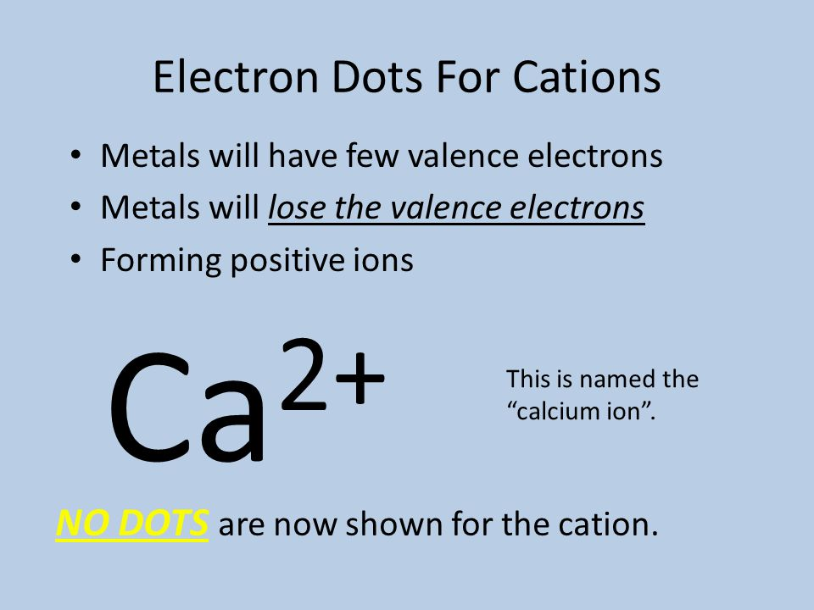
VALENCE ELECTRONS AND LEWIS STRUCTURES
Valence electrons are those in the outermost shell ( highest numbered shell) of an atom that normally contains electrons.
The Lewis structure for an atom or ion shows one dot for each of its valence electrons. Electrons in shells below the valence shell are known as core electrons. Core electrons are not involved in chemical bonding and these are not shown in the Lewis structure.
Lewis structure for Calcium atom Lewis structure for Calcium ion

Slide 13
Complete questions 6,7 and 8 from Essential Chemistry Unit 1&2 page: 51

